Slide 1



RELIABLE BOOKKEEPING, ACCOUNTING & TAX SUPPORT FOR MODERN BUSINESSES
www.obgoutsourcing.com

Slide 2
Table Of Content
Introduction
About Us
Vision and Mission
Our Services
Process flows at OBG
Our Team
Infrastructure at OBG
Our Software Certification
Software We Use
Why Need Accounting
Contact Us

Slide 3

Introduction
Founded in year 2013 with a target to provide excellent financial outsouricng services to valuable customers. we have domain expertise in Bookkeeping, Payroll, Tax, Reconciliation, Accounts Payable and Accounts Receivable management, inventory management, management reporting.
1

Slide 4

About Us
OBG Outsourcing is India based end to end bookkeeping and taxation service provider. A team of experts sharing knowledge with Small, Medium and Large organizations, Certified Public Accountants, Bookkeepers across the globe. We have expertise across all the major bookkeeping and tax software used in the industry such as QuickBooks (Desktop & Online), XERO Accounting, Sage, MYOB (Desktop & Online), Kashflow, GnuCash, Wave Accounting, Sassu, Mint, Tally, Oracle, SAP, Ultra Tax, Drake, ProSeries, Turbo Tax. OBG Outsourcing has obtained supremacy in preparing & maintaining the Management Reports, Financial Reports, Performance Reports, Ratio reports, Comparison Reports, Budgetary & Forecast Reports etc. (MIS Reports). OBG Outsourcing has proficiency in MS Excel, MS Access, MS Document, MS Power Point.
2

Slide 5


Vision and Mission
Vision
Mission
Our goal is to save time and money by streamlining and optimizing financial operations so the company can concentrate on expanding their businesses.
Our mission is to assist companies of all sizes in reaching their financial objectives by becoming the premier supplier of online bookkeeping and accounting services.
3

Slide 6
Our Services
Bookkeeping Services
Payroll Services
Tax Return
Sales Tax Compliance Services
4

Slide 7
Liceria & Co.
Liceria & Co.
Our Services
Business Process Improvement
Financial Statements
Standard Operating Procedure
Software Migration
5

Slide 8
Process Flows at OBG
Liceria & Co.
Liceria & Co.
Way to access information in Outsourcing
  Offline Access
2. Online Access
Follow the process suggested by client or create process for new systems.
6

Slide 9
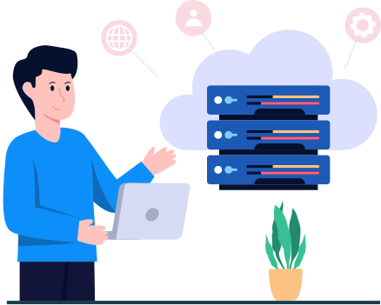





Offline Access
Liceria & Co.
Liceria & Co.
Client can download and restore data from secure server.
Client uploads data on server or email us
Team Access Secure Server or Email
After review work, data uploaded to secure server and inform to client.
Work is Distributed by Team Leader to Team Member. Discuss project and resolve of issues, if needed.
7
Once work completed by team member, work review by team leader with Management for quality assurance.

Slide 10




Online Access through remote desktop
Liceria & Co.
Liceria & Co.
Client Scans the documents and uploads
Work will be supervised by the team leader and management to ensure the highest quality standards.
Our team connects to the client’s computer via internet, using a remote desktop, team viewer, gotomypc , google chrome remote and logmein.
8

Slide 11
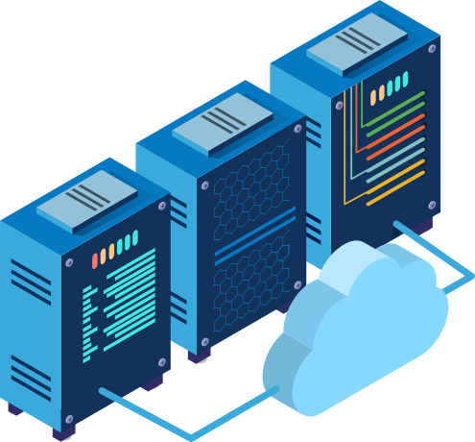




Online Process for Cloud based softwares
Liceria & Co.
Liceria & Co.
Client uploads data on secure server or email it to us via internet
Team access secure server and intimate back client on data received
Work distributed to team by
Team Leader
Team access cloud softwares e.g.
Quickbooks Online, xero, Myob, kashflow, sassu etc.
Client will be intimated on the progress of work regularly.
The Whole work is reviewed by team leader and management to provide quality services.
9

Slide 12

Infrastructure at OBG
Liceria & Co.
Liceria & Co.
OUR OUTSOURCING AMENITIES
SECURED INFRASTRUCTURES
SECURED FILE TRANSFER PROTOCOL FOR DATA TRANSMISSION
24/7 POWER BACKUPS AND 100 MBPS SPEED INTERNET AMENITIES
ALL TYPE OF COMMUNICATION FACILITIES ARE AVAILABLE
ANTIVIRUS INSTALLED AND UPDATED ON ALL SYSTEMS
10

Slide 13
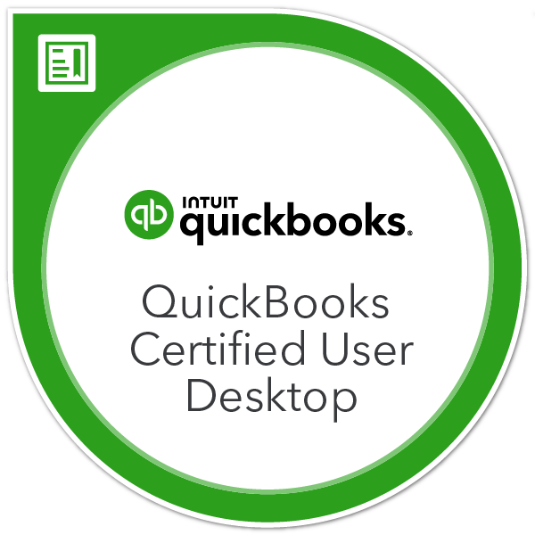

Our Software Certification
Liceria & Co.
Liceria & Co.
11

Slide 14


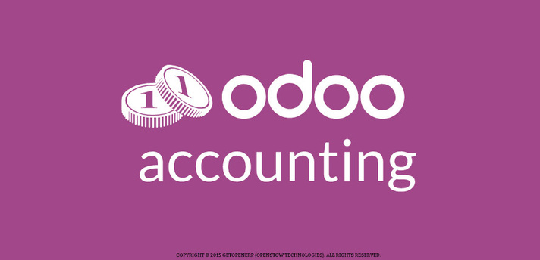










Software we use
Liceria & Co.
Liceria & Co.
12

Slide 15

Why Need Accounting
Calculating the profit or loss achieved in a company
Carry out control or supervision related to company activities
As important information used for decision making purposes
13

Slide 16




Contact Us
India
+91 8696916508
USA & Canada
+1(737)210-8542
UAE
+971-503916508
info@obgoutsourcing.com
www.obgoutsourcing.com
First Floor, Prithvi Tower, Prithvi Choraha, 117, Sumer Nagar, Mansarovar, Jaipur, Rajasthan 302020, India
14

